Slide 1

Near Earth Objects Group 2

Slide 2
Agenda
Background
Proposal
Data (?)
Trends / Correlations
Predictions
Conclusion
Next Steps
Q & A

Slide 3
Background
Infinite number of objects in space.
Pose potential threat to Earth.
Which objects can harm us?
Certified asteroids = NASA - Nearest Earth Objects

Slide 4
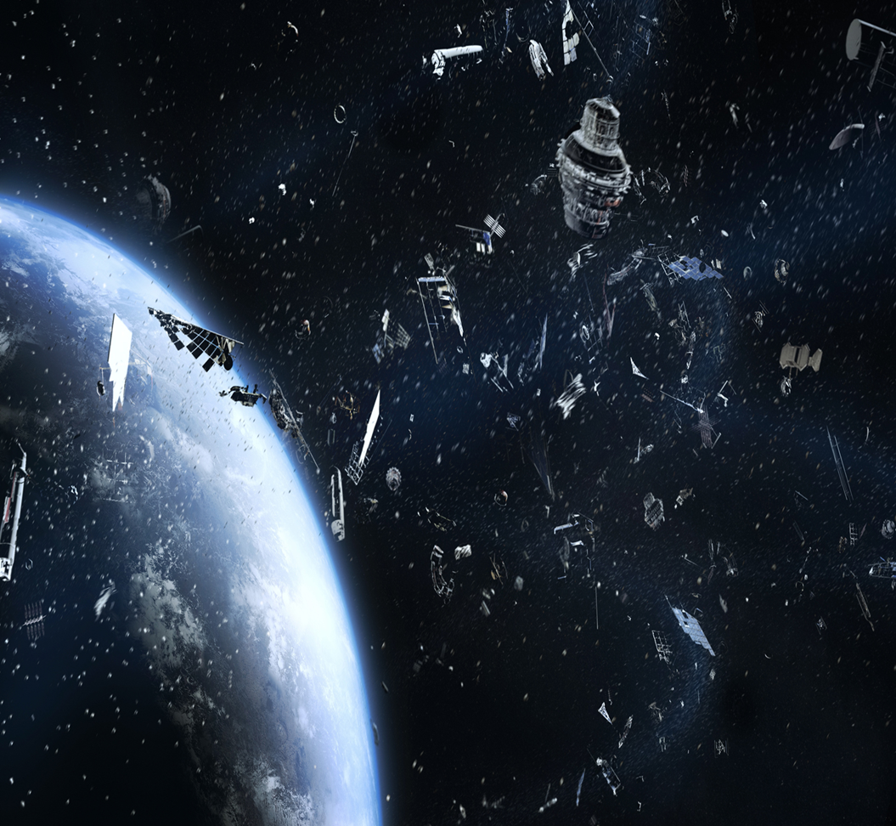
Proposal
Develop a model that can classify whether or not near-Earth objects pose a threat to satellites, disrupts natural phenomena, or is likely to impact Earth.
Utilize data from NASA’s Near-Earth Object Web Service for the model creation and testing.

Slide 5
Data
Used Nasa data from NEOwS API
Preprocessed data by removing unnecessary columns
Defined the target vector for items that are potentially hazardous
Data scaling required
Several models for preliminary evaluation
Is Potentially Hazardous
0 | 7666
1 | 552

Slide 6
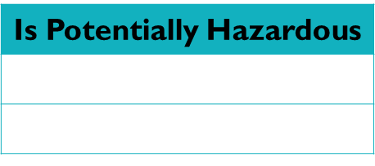
Models
Model Used for Predictions | Train Accuracy | Test Accuracy | Balanced Accuracy Score
SVC- rbf (Standard Scaler) | 0.940 | 0.931
SVC – rbf (Mini Max Scaler) | 0.935 | 0.927
Random Forest (max depth = 3) | 0.9436962518254097 |  | 0.5689501312335958
This suggests the model is not great at identifying hazardous asteroids potentially due to the extent to which the data is imbalanced. This false negative could be potentially catastrophic.
Efforts needed to improve model performance at detecting hazardous astroids
Resampling needed: Resampled Value Counts

Slide 7
Plot the scores dataframe WORKING
xxxxxxx

Slide 8
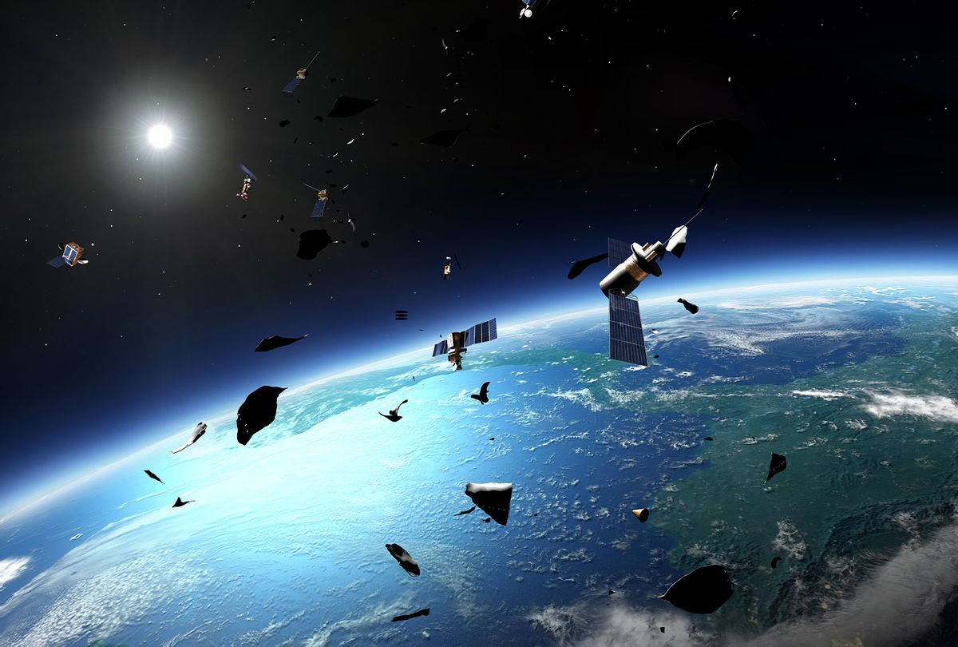
Resampled Data
Classification reports for Random Forest with max_depth of 3 using predictions from resampled model using random_oversampler vs original data:
(SMOTE used)
Original_data
precision recall f1-score support
0 0.94 1.00 0.97 1905
1 0.84 0.14 0.24 150
accuracy 0.94 2055
macro avg 0.89 0.57 0.60 2055
weighted avg 0.93 0.94 0.91 2055
Using random_oversampler
precision recall f1-score support
0 1.00 0.83 0.91 1905
1 0.31 0.99 0.48 150
accuracy 0.84 2055
macro avg 0.66 0.91 0.69 2055
weighted avg 0.95 0.84 0.88 2055

Slide 9
Improve Model Performance
Retrieve more real data from NASA
Modified create_dataset script to get additional records
Created new Random Forest Model
Target value counts with new data:
Is Potentially Hazardous
0 | 7666
1 | 2164
Random Forest Accuracy Scores with new data
Testing data accuracy score: | 0.8677786818551668
Training data accuracy score: | 0.8700488334237656
Balanced Accuracy Score: | 0.9088360226645182

Slide 10
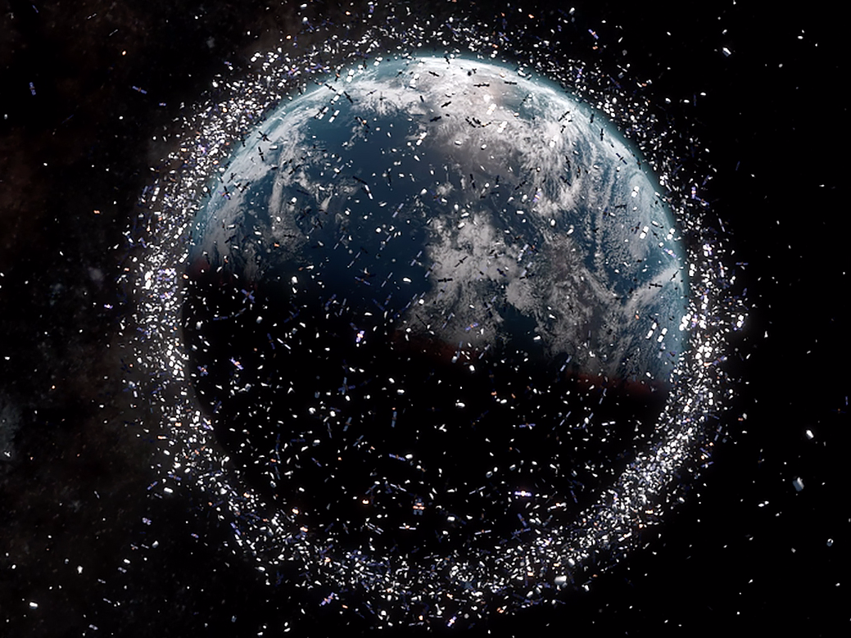
Classification Report with New Data
Classification report with New Data….
With new data
precision recall f1-score support
0 0.99 0.83 0.91 1902
1 0.63 0.98 0.77 556
accuracy 0.87 2458
macro avg 0.81 0.91 0.84 2458
weighted avg 0.91 0.87 0.88 2458

Slide 11
Trends & Correlations Placeholder
Bullets or sentences
Bullets or sentences
Metric | Measurement | Target | Actual
Audience attendance | # of attendees | 150 | 120
Engagement duration | Minutes | 60 | 75
Q&A interaction | # of questions | 10 | 15
Positive feedback | Percentage (%) | 90 | 95
Rate of information retention | Percentage (%) | 80 | 85

Slide 12
Conclusion
Xxxxxxxxx xxxxxxxxxxxxxxxxxxxxxx xxxxxxxxxx
Ssssssssssss sssssss ssssssssssssss. Ssssssssssssssssss
Xsssssssssssssssssss

Slide 13
Questions

Slide 14
Extra slides – delete after final copy

Slide 15
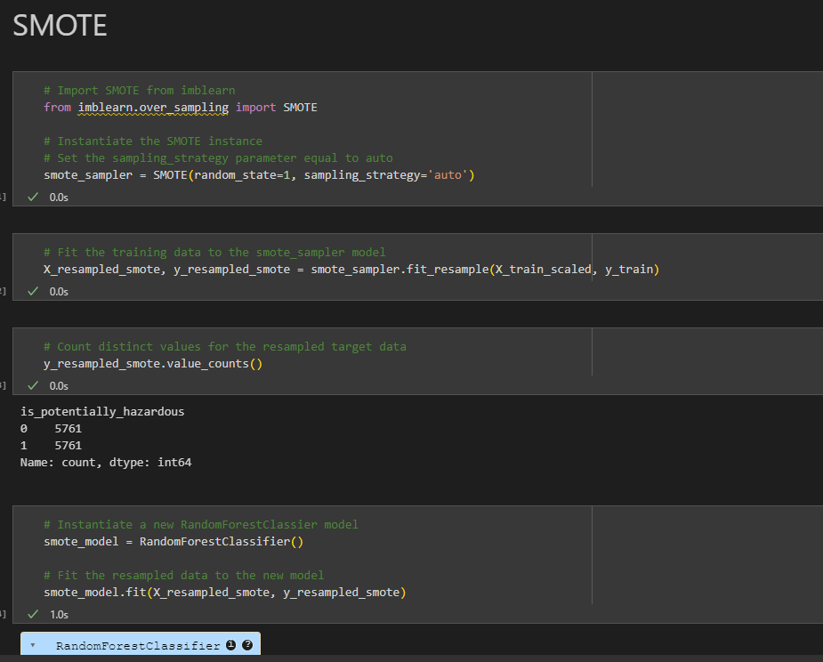
Highlight the use of SMOTE SOMEHOW
Placeholder please redo using data;
make visually pleasing

